Slide 1

Threat Hunting Your Alerts
Stuart McIntosh
Bsides Splunk
Notes:
Intro on my experience

Slide 2

AGENDA
1
Threat Hunting Approach
2
Benefits of SOC hunting
3
SOC Hunt Examples
4
Lessons Learned

Slide 3
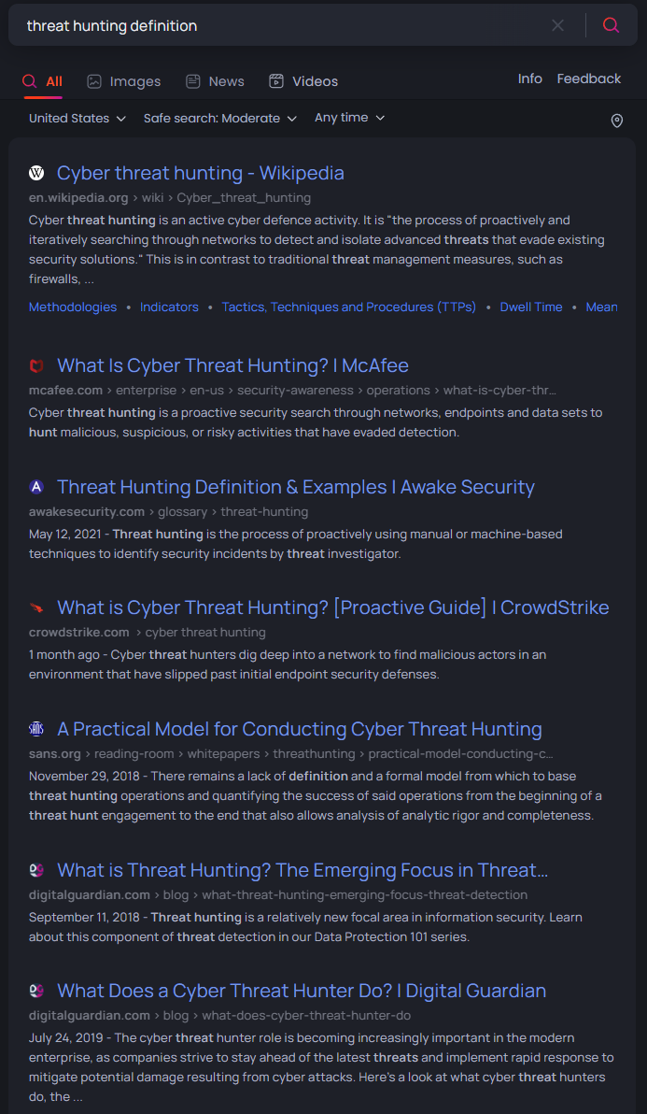
THREAT HUNTING APPROACH
Many personalized versions of what is meant by Threat Hunting
High level version:
The process of proactively and iteratively searching through networks to detect and isolate advanced threats that evade existing security solutions
What if we could adjust this:
The process of proactively and iteratively searching through ALERT DATA to detect and isolate ANOMALIES that evade existing SOLUTIONS
What could we learn from taking an iterative search through our alert and response data?

Slide 4
BENEFITS OF SOC HUNTING
STRENGTHEN CONTROLS
SITUATIONAL AWARENESS
REMOVE NOISE
Controls that can be switched from audit to block mode
Method for identifying if a control change worked
Controls that can prevent multiple alerts
Analyst closing with different statuses
Trending around sources
Trending around fidelity
Duplicating alert sources
Common benign objects
Tune calculated thresholds
Tune environment changes

Slide 5
SOC HUNT EXAMPLES

Slide 6
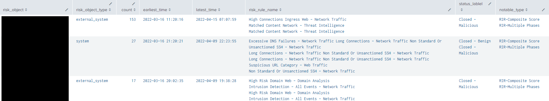
HUNT – REPEATED ALERTS
Goal: What is causing repeating alerts over a given timeframe?
Adjustments:
Timeframe – the greater the range, the greater chance of spotting a pattern
Count – the number of repeats or greater that you want to surface, keep in mind your throttling approach
Duration – the time between earliest and latest seen for the alert
What does this mean:
These findings represent a behavior or action that is re-occurring and then causing the alerts
Each finding should be either tuned or remediated
Start with the highest count/most impactful
`notable`
| fillnull value="" system user orig_tag
| nomv risk_rule_name
| stats count, earliest(_time) as earliest_time,
latest(_time) as latest_time,
values(risk_rule_name) as risk_rule_name,
values(status_label) as status_lablel,
values(rule_name) as notable_type
by risk_object,risk_object_type
| where count>4
| convert timeformat="%Y-%m-%d %T" ctime(latest_time), ctime(earliest_time)
| sort - count

Slide 7
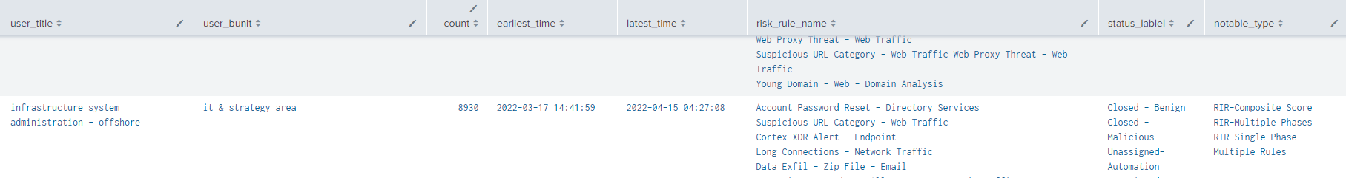
HUNT – ALERTS BY BUSINESS UNITS
Goal: Are there groups of users causing more alerts than others?
Adjustments:
Timeframe – the greater the range, the greater chance of spotting a pattern
Count – the number of alerts or greater that you want to surface
Title or Bunit – flip between them to see if themes emerge
What does this mean:
These findings represent a behavior or action that seems to be from a common group of users
Each finding should be investigated, there tends to be a collision between their processes and security technologies
Start with the highest count/most impactful that is a group you could work through this with
`notable`
| fillnull value="" system user orig_tag
| nomv risk_rule_name
| stats count, earliest(_time) as earliest_time,
latest(_time) as latest_time, values(risk_rule_name) as risk_rule_name,
values(status_label) as status_lablel, values(rule_name) as notable_type
by user_title, user_bunit
| where count>4
| convert timeformat="%Y-%m-%d %T" ctime(latest_time), ctime(earliest_time)
| sort - count

Slide 8
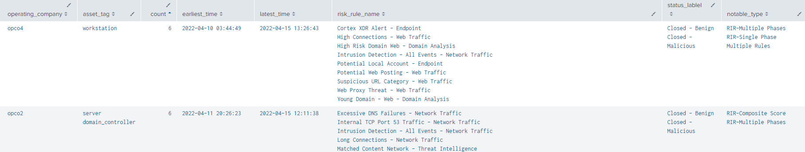
HUNT – ALERTS BY SYSTEM TYPE
Goal: Are there groups of systems causing more alerts than others?
Adjustments:
Timeframe – the greater the range, the greater chance of spotting a pattern
Count – the number of alerts or greater that you want to surface
Asset tag, operating system, operating company
What does this mean:
These findings represent a behavior or action that seems to be from a category or type of system
Each finding should be investigated, look for pci or domain_controller tags for higher urgency
Work with technology partners to help refine the security controls
`notable`
| fillnull value="" system user orig_tag
| search risk_object_type=system
| lookup asset_lookup_by_str asset as risk_object
| nomv asset_tag
| stats count, earliest(_time) as earliest_time, latest(_time) as latest_time,
values(risk_rule_name) as risk_rule_name,
values(status_label) as status_lablel, values(rule_name) as notable_type
by operating_company, asset_tag
| where count>4
| convert timeformat="%Y-%m-%d %T" ctime(latest_time), ctime(earliest_time)
| sort - count

Slide 9
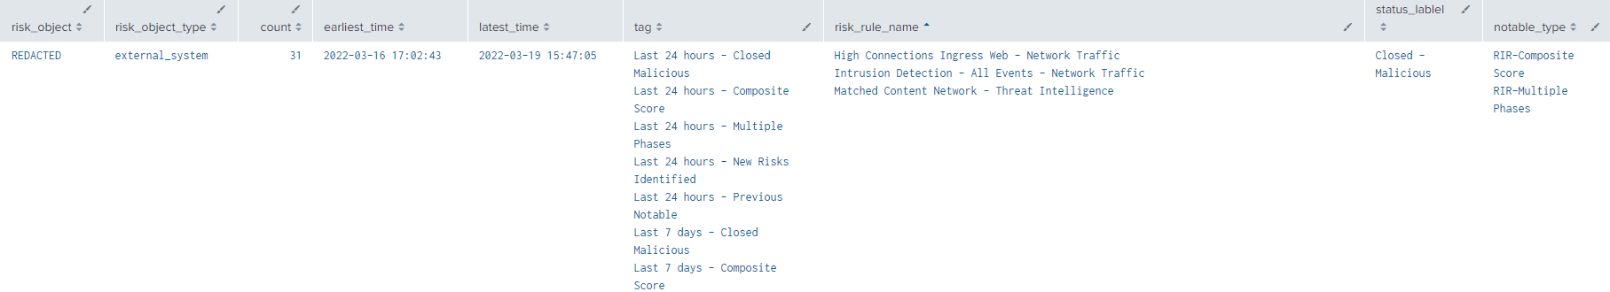
HUNT – ALERTS WITH MULTIPLE INDICATORS
Goal: Are there entities causing more alerts with different indications?
Adjustments:
Timeframe – the greater the range, the greater chance of spotting a pattern
Count – the number of alerts or greater that you want to surface
Tag – can look at the ones you may be using
What does this mean:
These findings are where a system or user had a malicious alert prior and are continuing to throw malicious ones
Each finding should be investigated and the system remediated
`notable`
| fillnull value="" system user orig_tag
| search tag="*- Closed Malicious"
| stats count, earliest(_time) as earliest_time, latest(_time) as latest_time,
values(tag) as tag, values(risk_rule_name) as risk_rule_name,
values(status_label) as status_lablel, values(rule_name) as notable_type
by risk_object, risk_object_type
| where count>4
| convert timeformat="%Y-%m-%d %T" ctime(latest_time), ctime(earliest_time)
| sort - count

Slide 10
LESSONS LEARNED

Slide 11

LESSONS LEARNED
Stick with it
In just a couple of cycles you will see the value but stay curious
Not too much
It is exciting finding systems and controls to adjust but be careful not to burden your engineers and partners with too many changes
Consistent Response
Not all analysts have the same knowledge, be sure to help all of them to approach response in a standardized way

Slide 12

Thank you
outpost-security.com/slack
stuart@outpost-security.com

